Slide 1

KRISHI SHAKTI A Krishi bhavan based project for farmers
Helna Sunny
FIT20MCA-2058

Slide 2

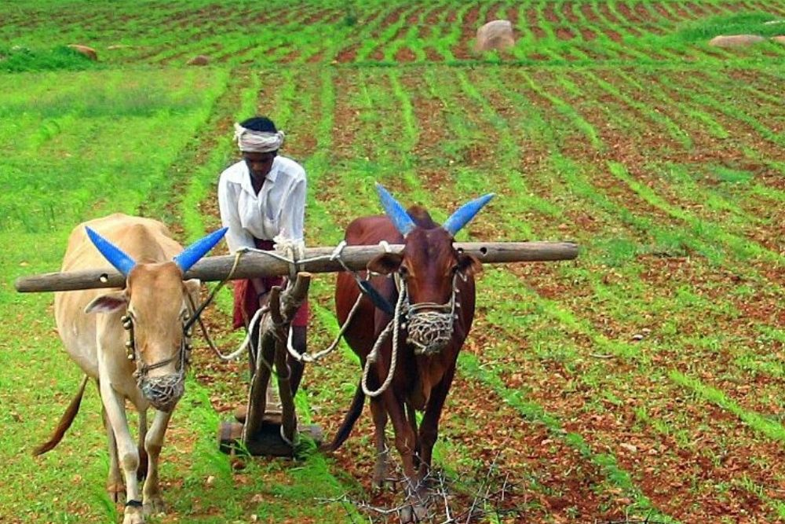
Relevance of the topic
Understand the need and awareness of Krishi bhavan services to farmers of Kodassery panchayath.
Many are not aware of the services which is provided by the Krishi bhavan to farmers.

Slide 3
DESCRIPTION
Android project, which is developed for the farmers of kodassery panchayath.
Krishi bhavan is a social institution that is established in panchayaths in Kerala to satisfy the timely and precise need of farmers.
This aim of the project is to make aware to all the farmers of this area about services of Krishi bhavan.

Slide 4
OBJECTIVES
To provide the awareness related to farming to the people of this area.
To support the farmers of the society.
To enhance the production of crops.

Slide 5
MODULES
User management
News management
Pension management
Review management
Idea management
Training management

Slide 6
User Management
Registration
Login
News Management
This module contains details about the daily news.
Admin updates the information and users can view it.
Users can apply for the soil test and admin can view the registered users for soil test.

Slide 7
Pension Management
This module contains details about farmer pension.
Admin updates the news about pension and users need to apply for the pension.
Admin gets the pension requests and approves if needed.
If he approves the user gets the information.
Only admin has the power to approve the pension requests.

Slide 8
Review Management
This module contains reviews and comments.
Both users and admin can update the review.
Both of them can view all the reviews.
We cannot change others review.

Slide 9
Idea Management
This module contains different ideas related to agriculture
Different plants and crops that grow in this area.
What is the best climate, soil type, days to harvest..etc

Slide 10
Training Management
This module contains details about different training programs.
Registered users can apply for different training programs which are scheduled offline.
If they are not able to attend the offline training, they can attend online training program

Slide 11
EXISTING AND PROPOSED SYSTEM
Existing system - doesn’t have an app for farmers of Kodassery panchayath.
Farmers are not fully aware of the services.
Only offline training programs are held. But in proposed system, we will upload the videos of the training program for those who were not able to attend.
Krishi bhavan is not able to know the feedback of people to improve their services.

Slide 12

Splash Screen

Slide 13
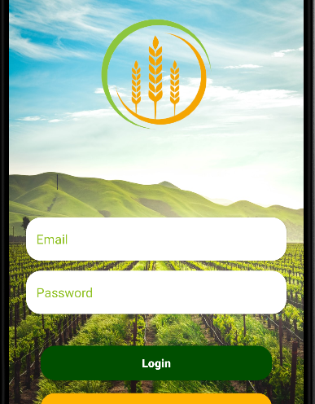
Login page

Slide 14
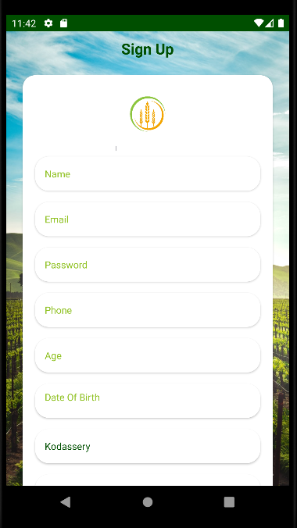
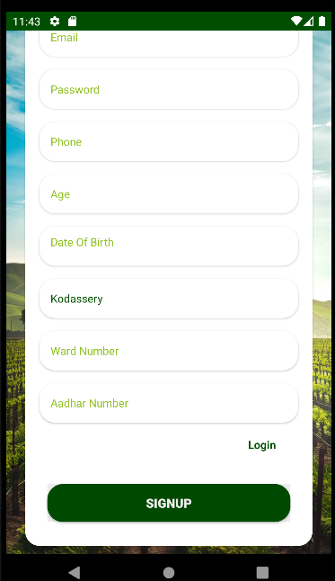
SIGN UP

Slide 15
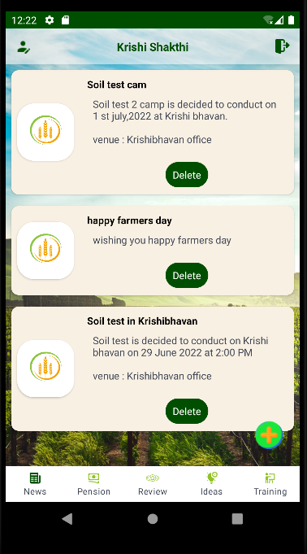
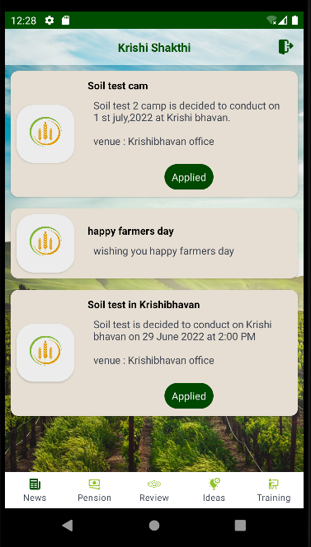
NEWS MODULE

Slide 16
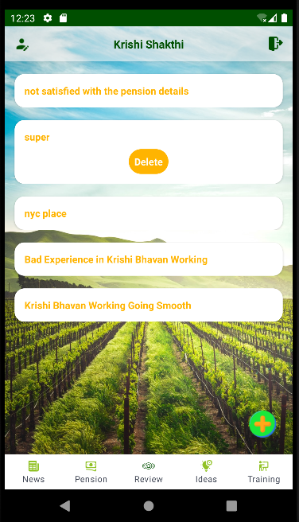
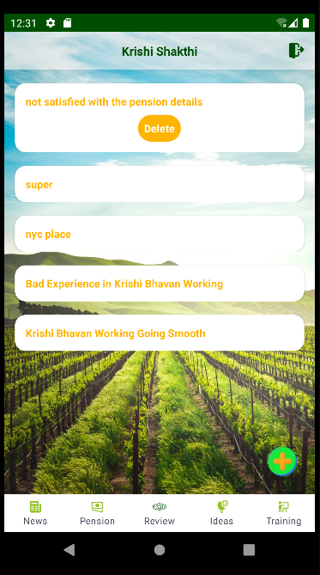
REVIEW MODULE

Slide 17
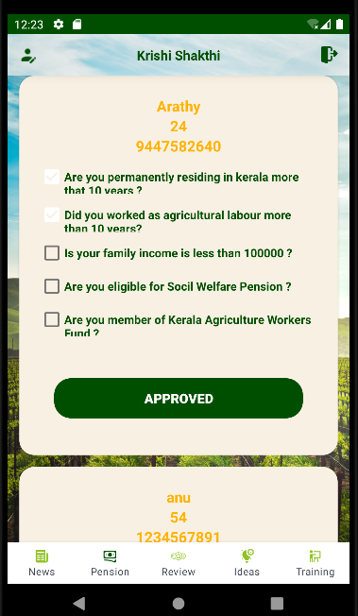

PENSION MODULE

Slide 18


TRAINING MODULE

Slide 19
Thank you

